Slide 1

Bauman Moscow State Technical University
Military aircraft
Student: Sanginov Azamat
Group: IU7-31
Moscow, 2018

Slide 2
Contents
History
Combat aircraft
Fighter aircraft
Bomber aircraft
Attack helicopter
Thoughts on military industry

Slide 3
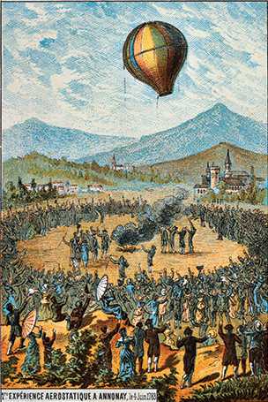
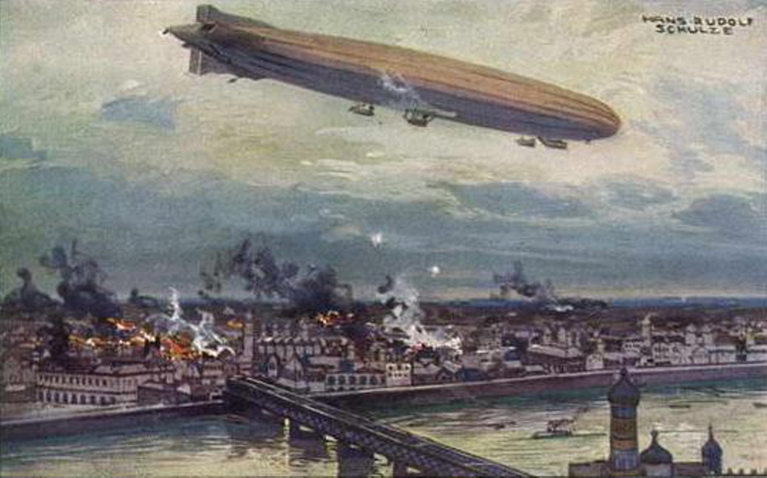
Aerostats and dirigibles
German airship Schütte Lanz SL2 bombing Warsaw in 1914

Slide 4
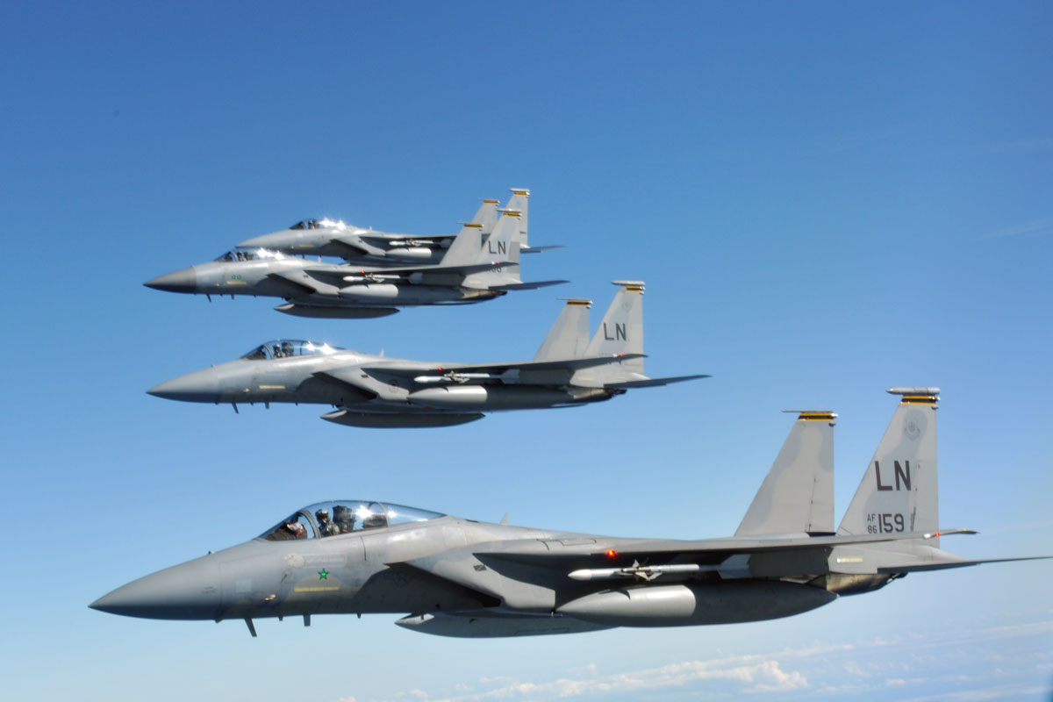
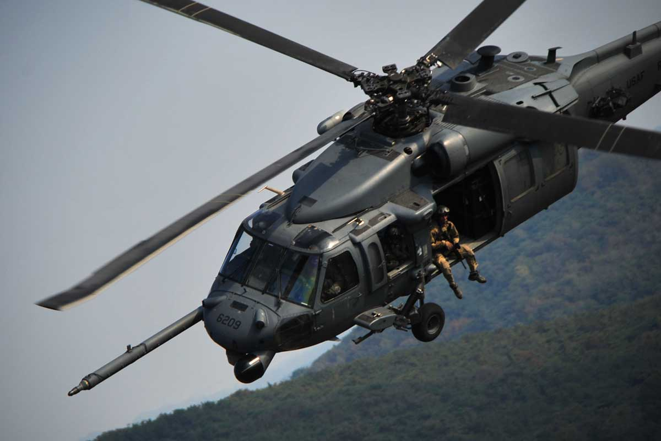
Combat aircraft
F-15 Eagle
HH-60G PAVE Hawk

Slide 5
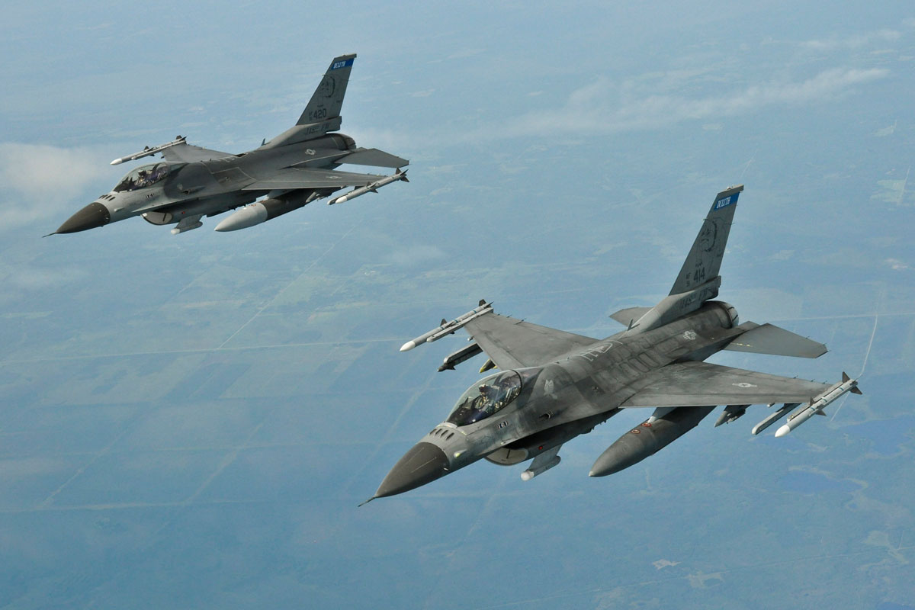
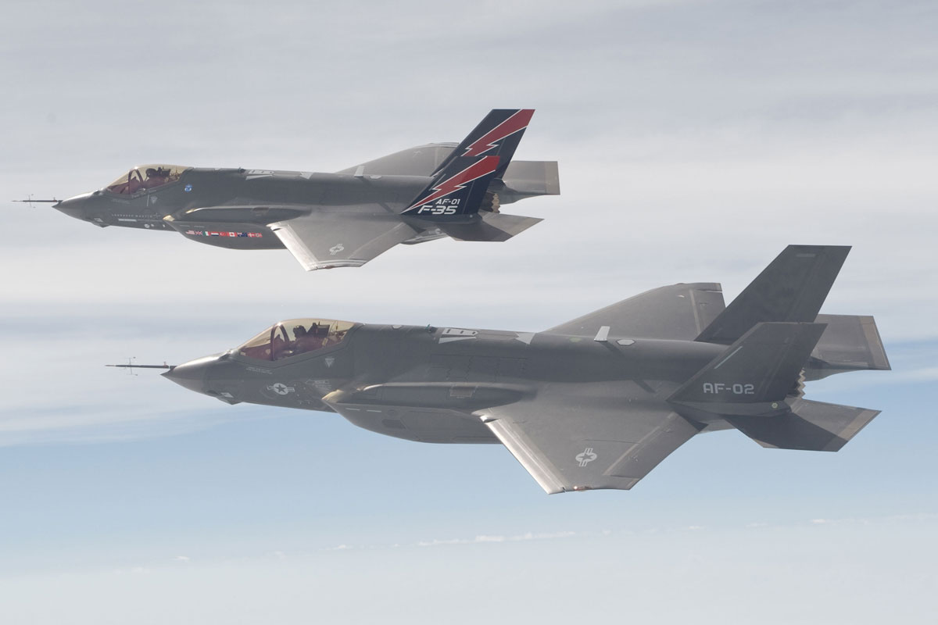
Fighter Aircraft
F-35С Lightning II
F-16 Fighting Falcon

Slide 6
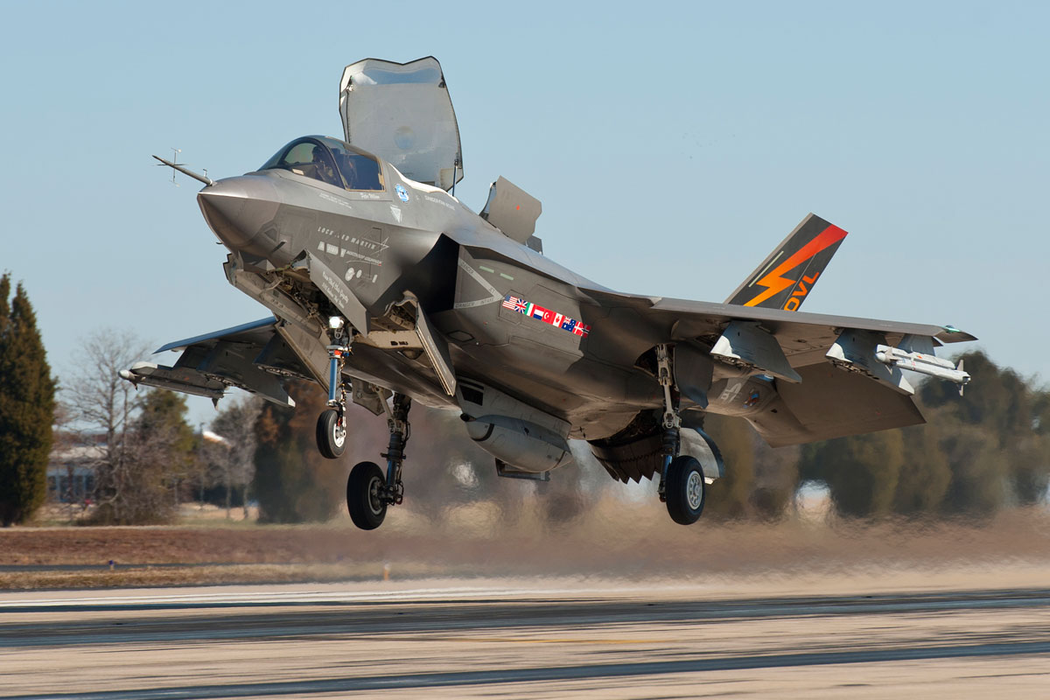
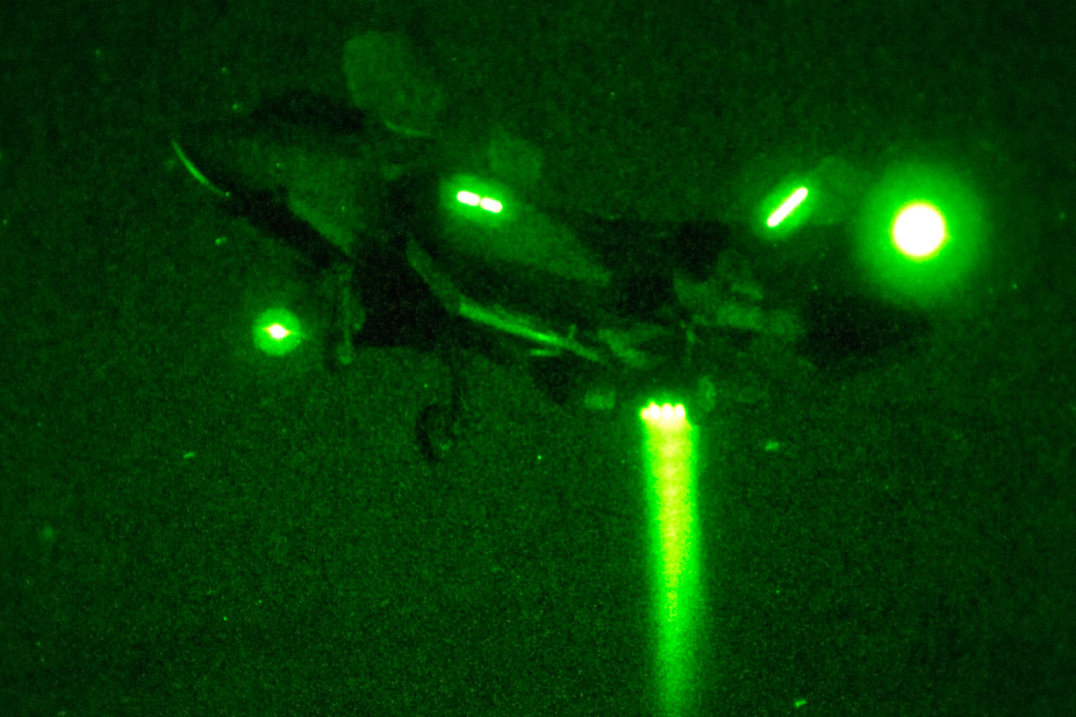
F-35B Lightning II

Slide 7
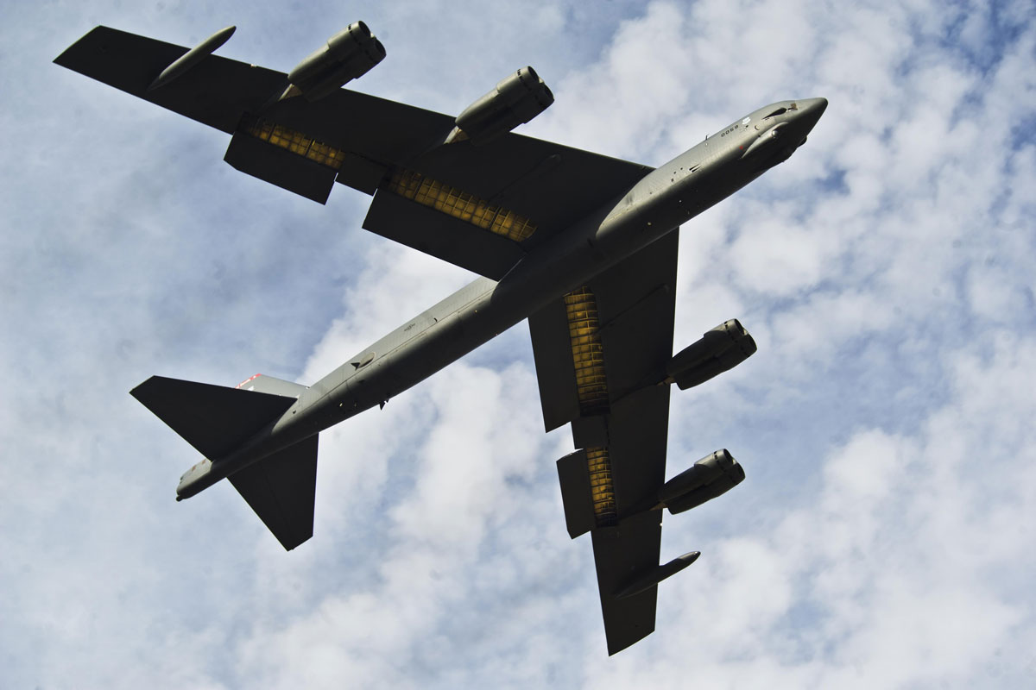
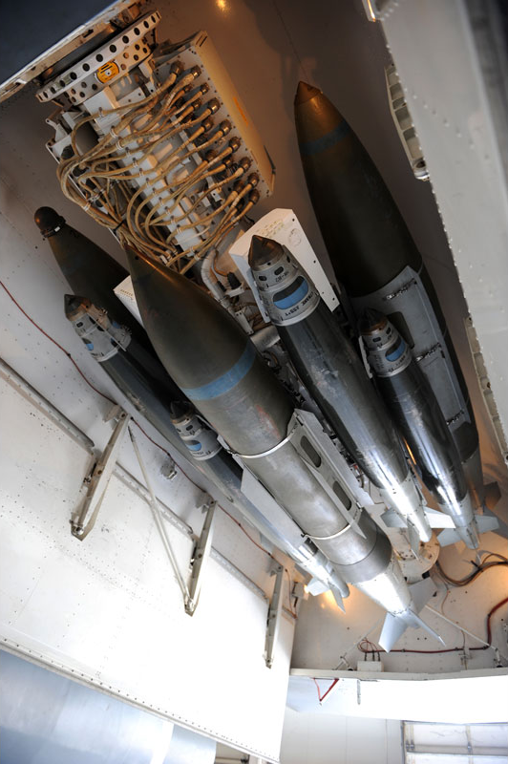
Bombers
B-52 Stratofortress

Slide 8
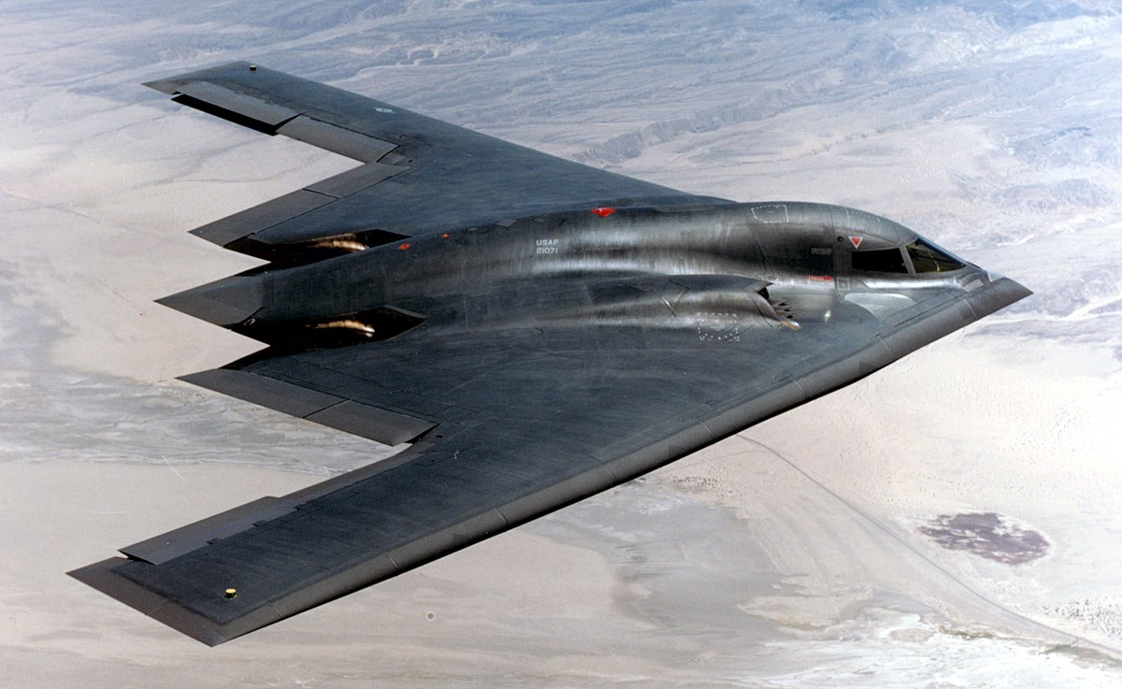
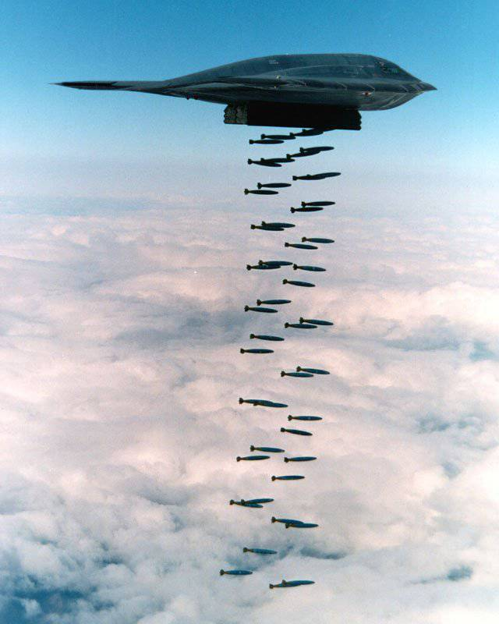
B-2 Spirit

Slide 9
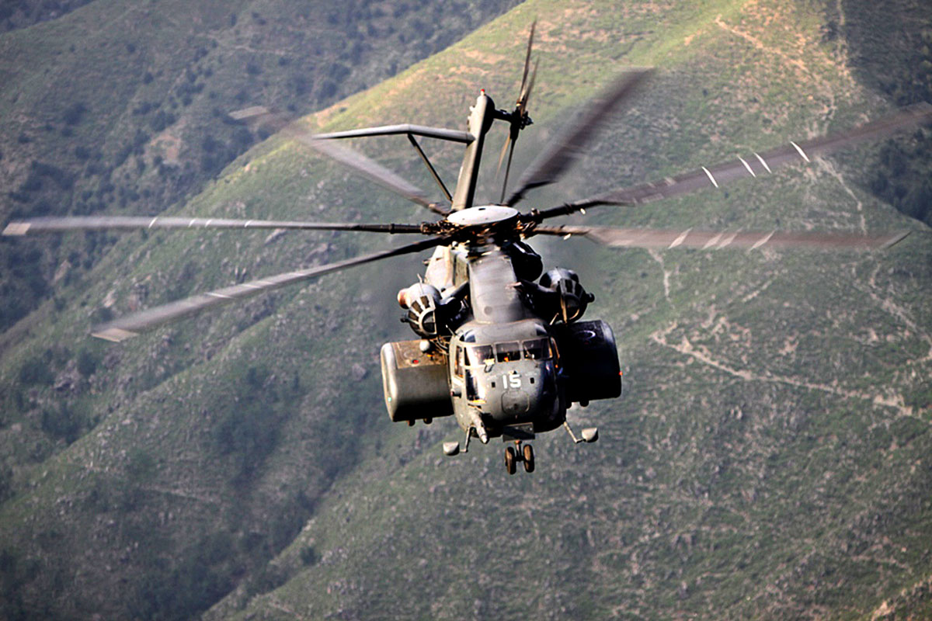
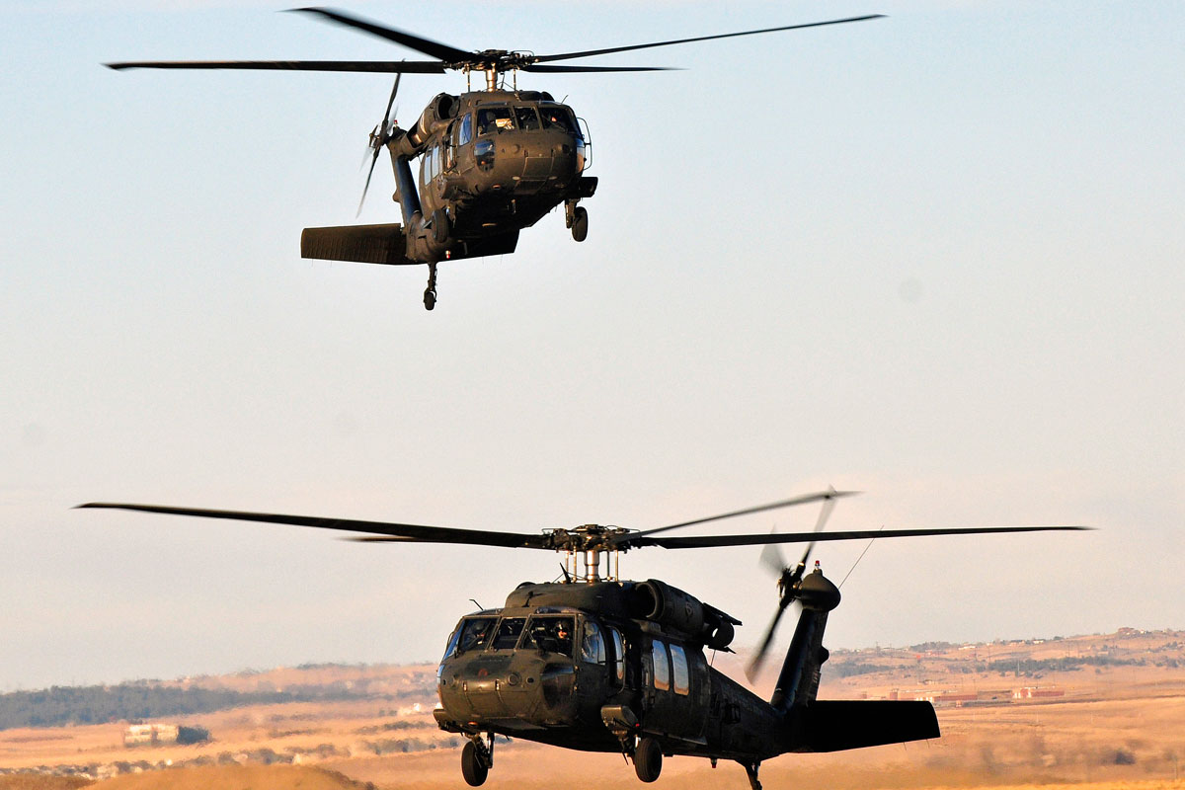
Attack helicopters
MH-53E Sea Dragon
UH-60A/L Black Hawk Helicopter

Slide 10
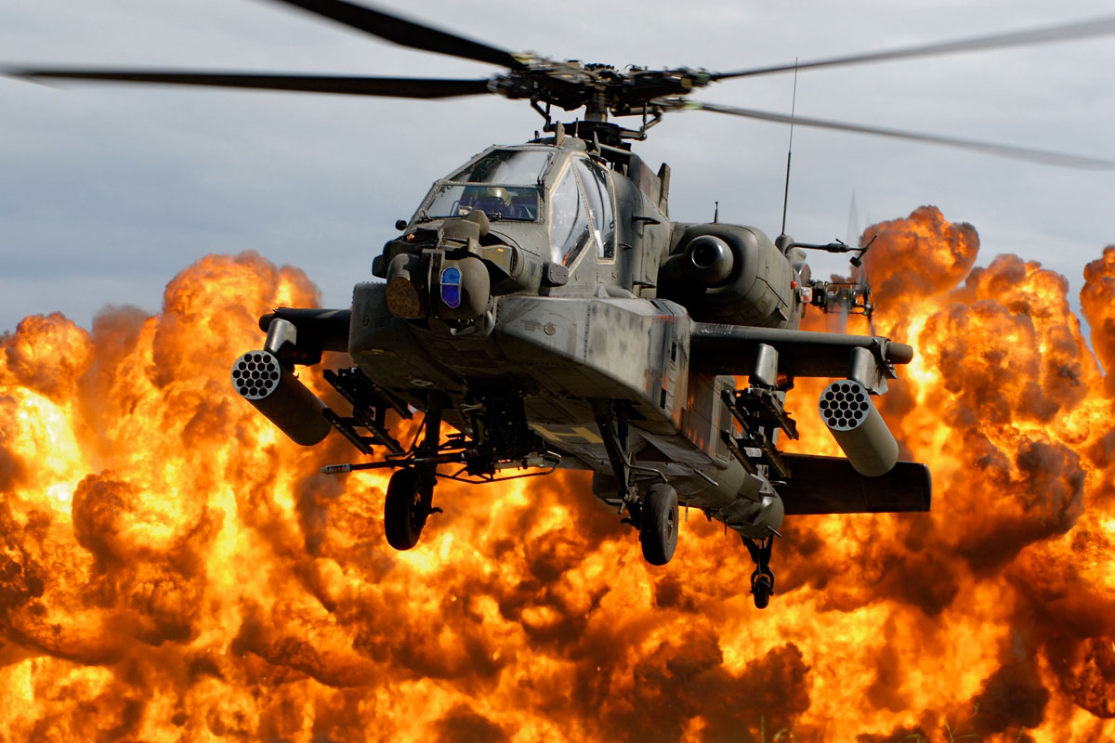
AH-64 Apache Longbow

Slide 11
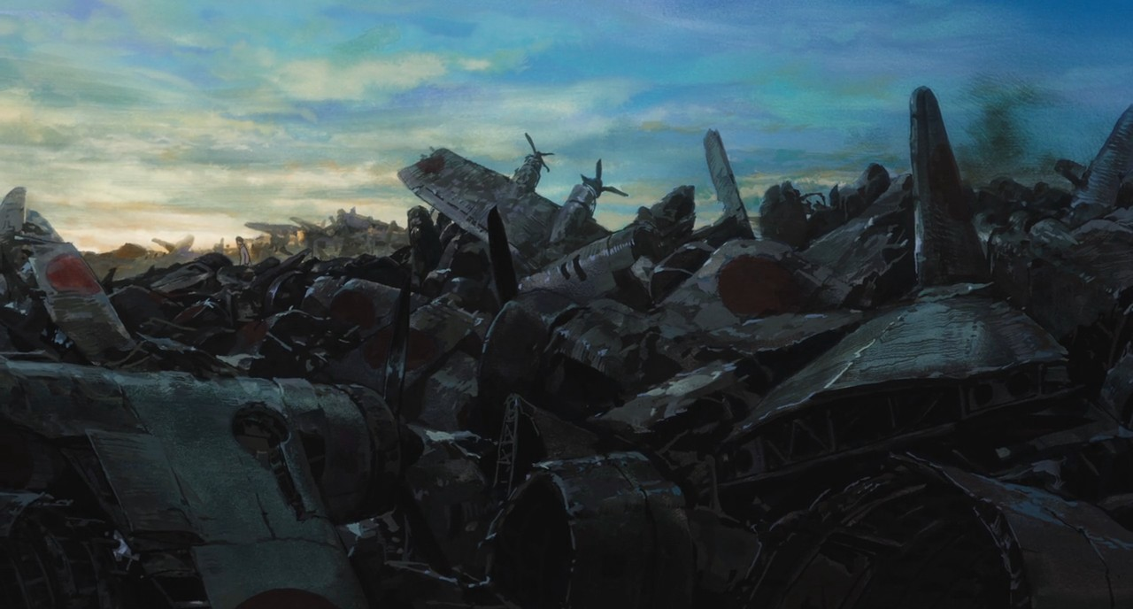
Their helicopters sing

Slide 12
References
https://www.flightglobal.com/pdfarchive/view/1912/1912%20-%200298.html
https://en.wikipedia.org/wiki/Airship
https://www.military.com/equipment/f-35b-lightning-ii
https://en.wikipedia.org/wiki/Fighter_aircraft
https://en.wikipedia.org/wiki/Bomber
https://www.military.com/equipment/b-2-spirit
https://www.military.com/equipment/ah-64-apache-longbow
https://en.wikipedia.org/wiki/Attack_helicopter
Music:
Godseep you! Black Emperor – Their Helicopters sing
Godseep you! Black Emperor – 09-15-00

